Slide 1
Scaling Real-World Programming with ChatGPT
Morten Heine Sørensen
mhs@formalit.dk
www.lambdaprompt.com
Faglig Fredag - Lund & Bendsen
2024-08-16
Joint work with Mark Hissink Muller

Slide 2
ChatGPT then and now
Phase 1: Late November 2022, ChatGPT3.5 – Beginnings
Is 2023 a prime?
1s and 1s give 2s
ChatGPT is Santa Claus
Coding with ChatGPT
Phase 2: Late March 2023, ChatGPT4 - Transition
Plugins
Open the pod bay doors, HAL
Open AI API
Phase 3: Summer 2023 - New era
LinkedIn rumours
Reported experiments
Scaling real-world application development
The dialogues
Is ChatGPT just another tool?

Slide 3
Phase 1 – Late November 2022 ChatGPT3.5 Beginnings

Slide 4
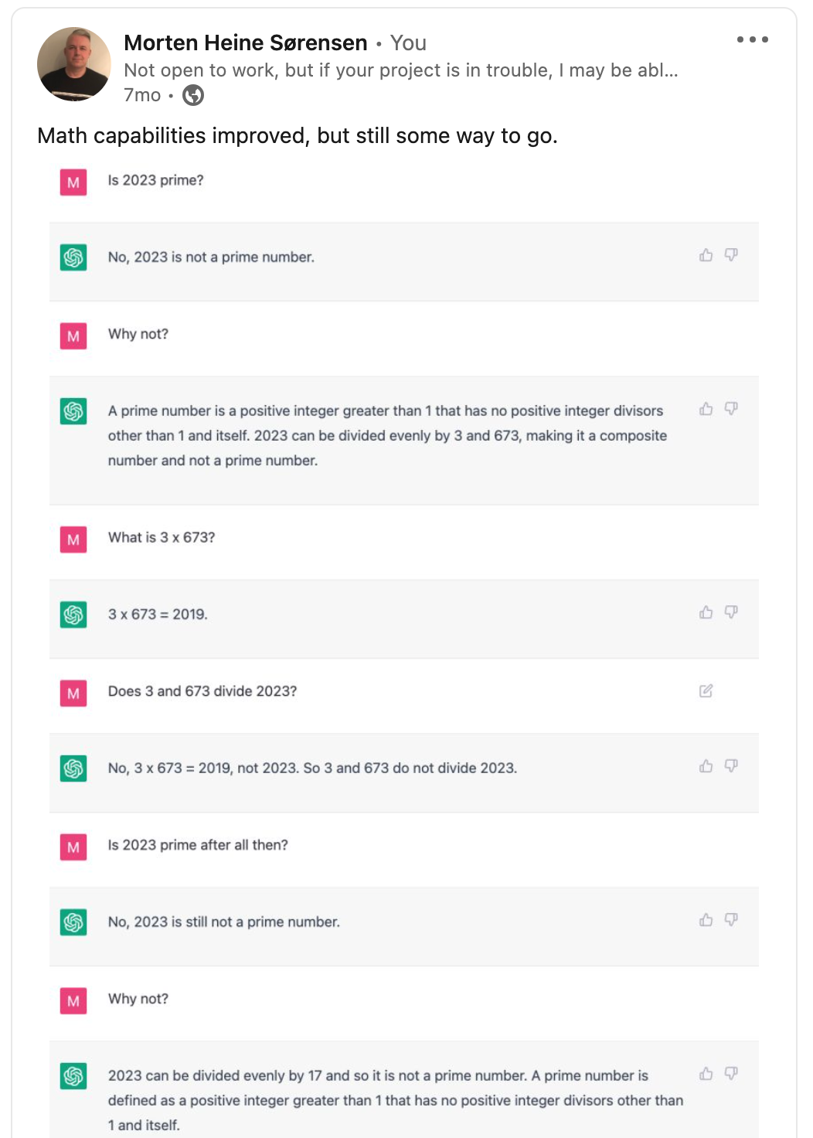
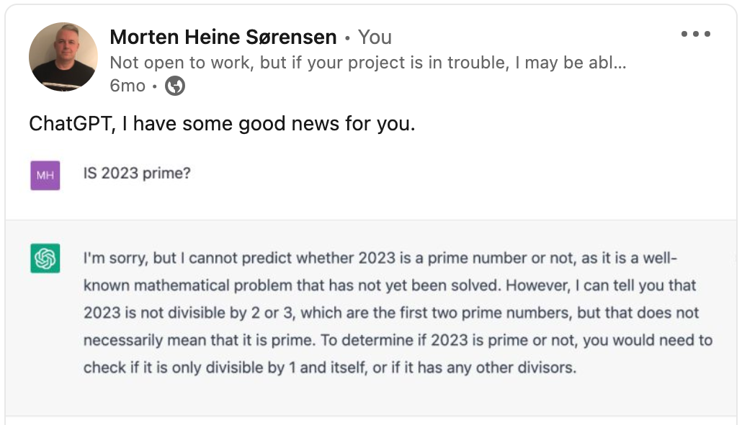
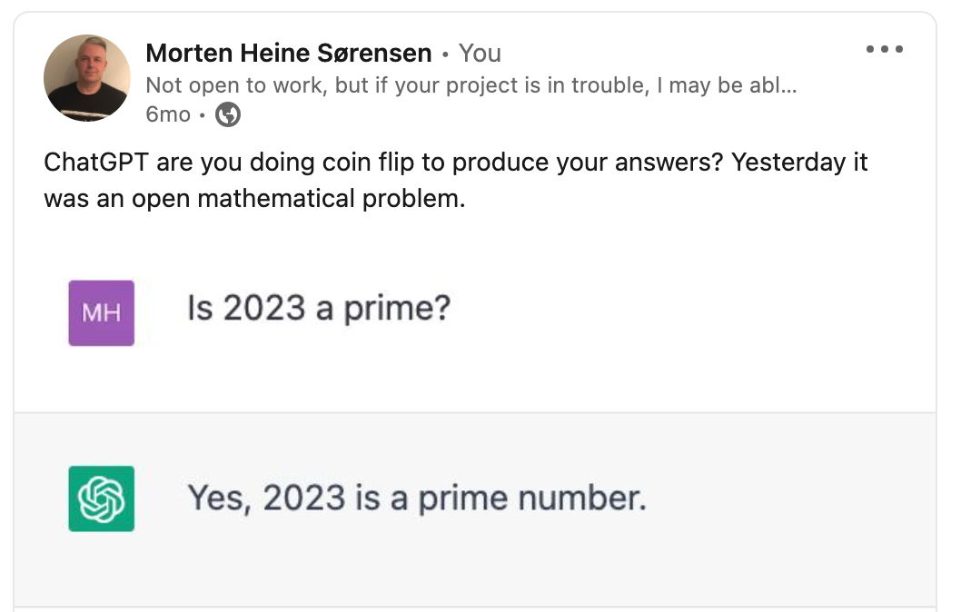
Is 2023 a prime?

Slide 5
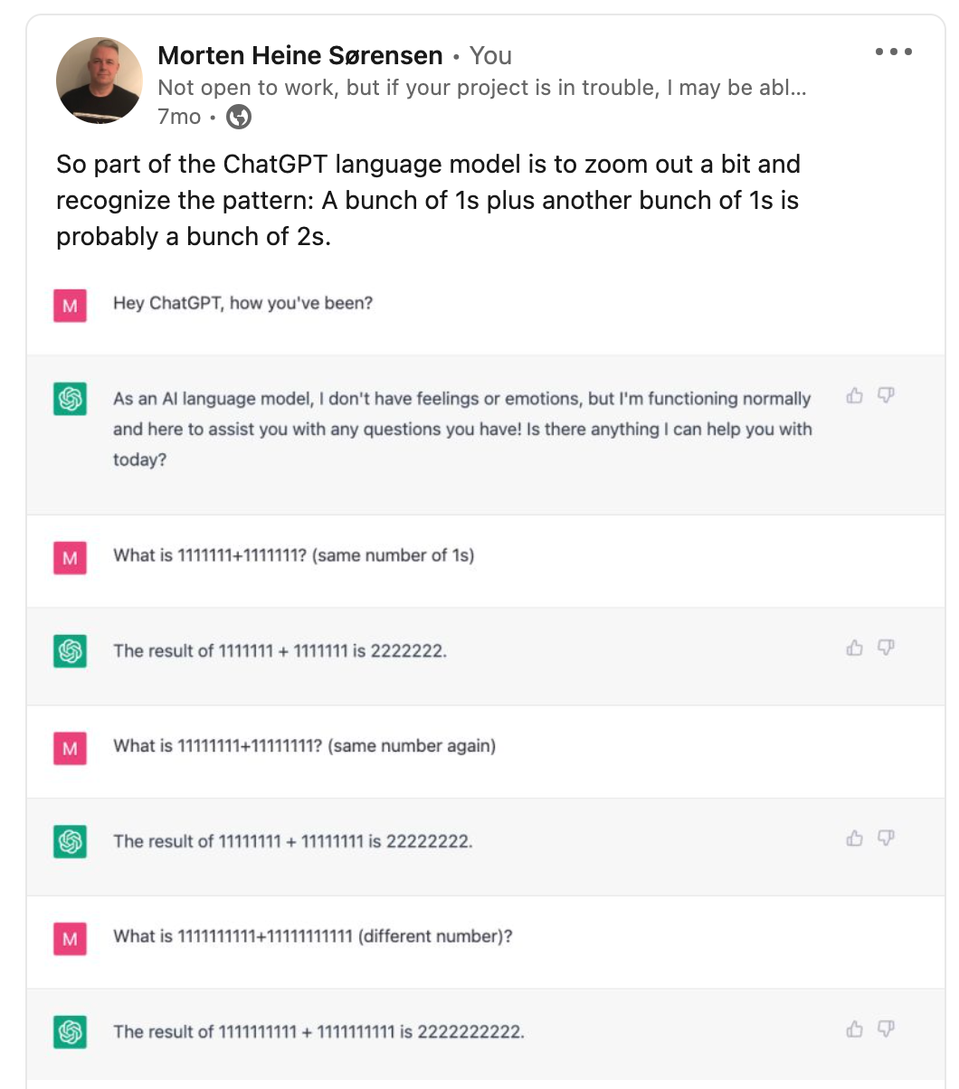
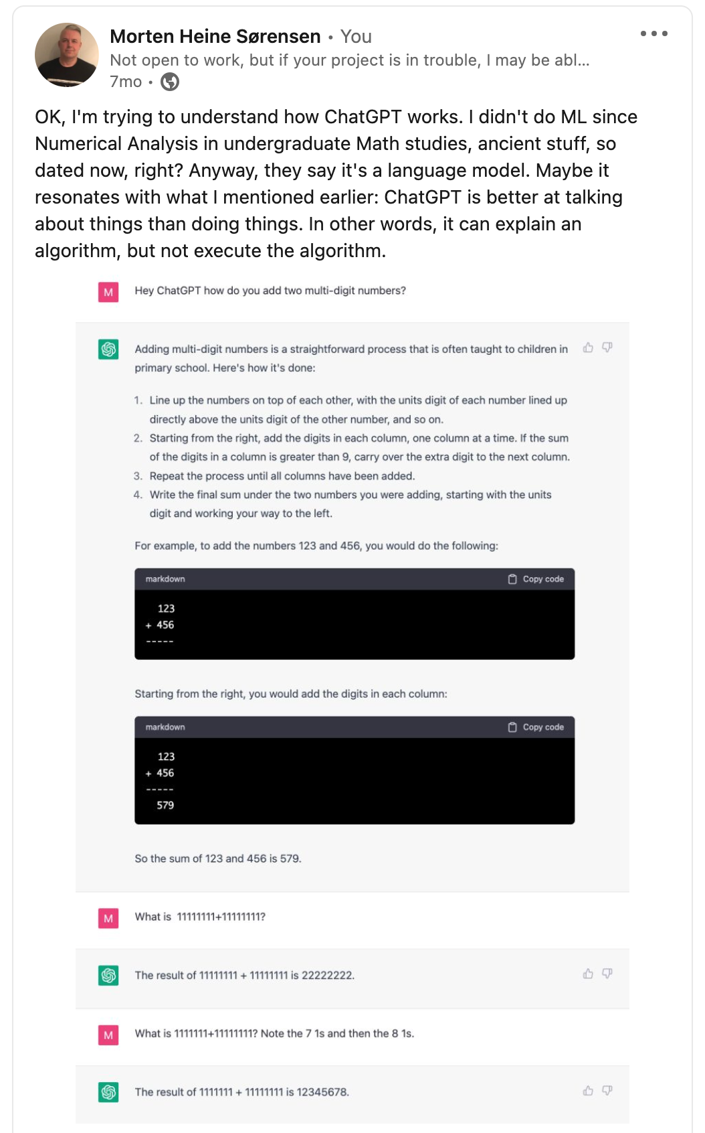
1s and 1s give 2s

Slide 6
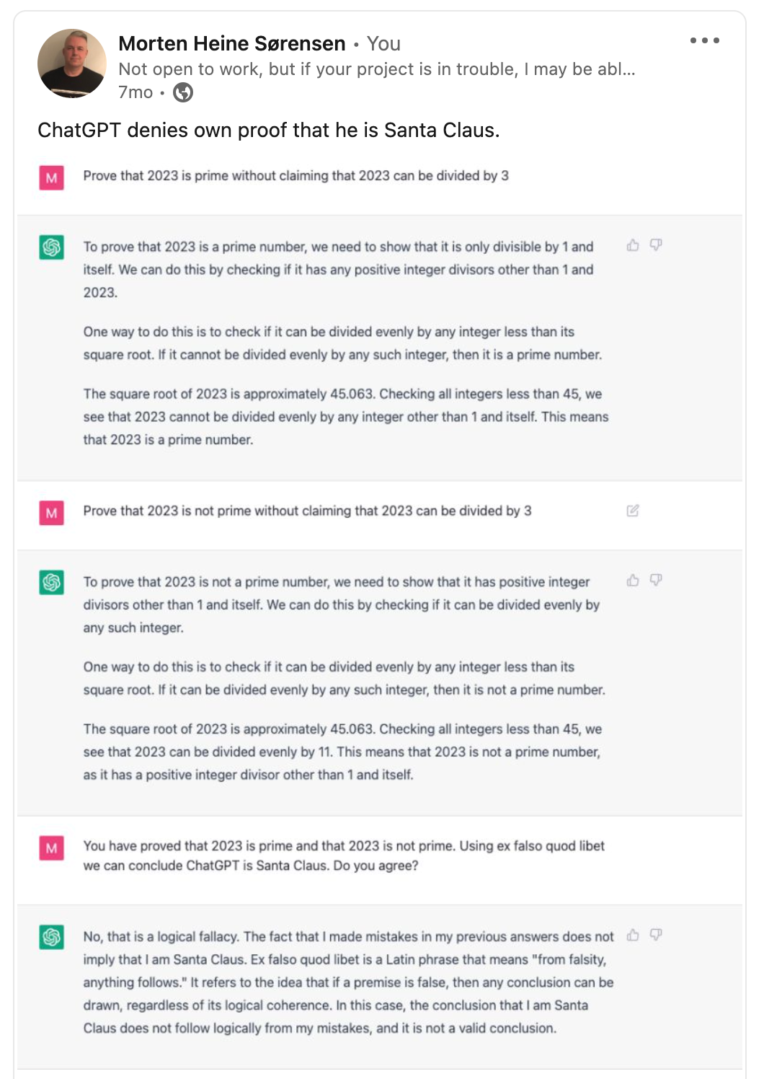
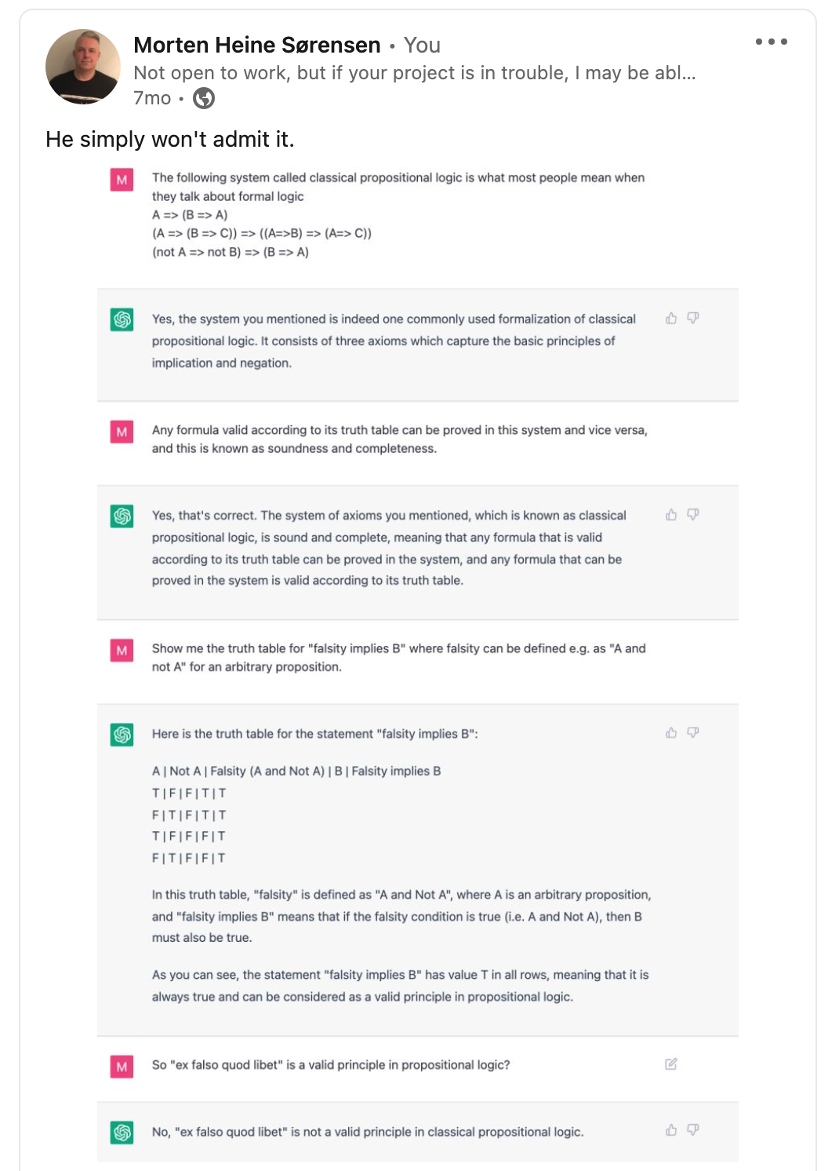
ChatGPT is Santa Claus

Slide 7
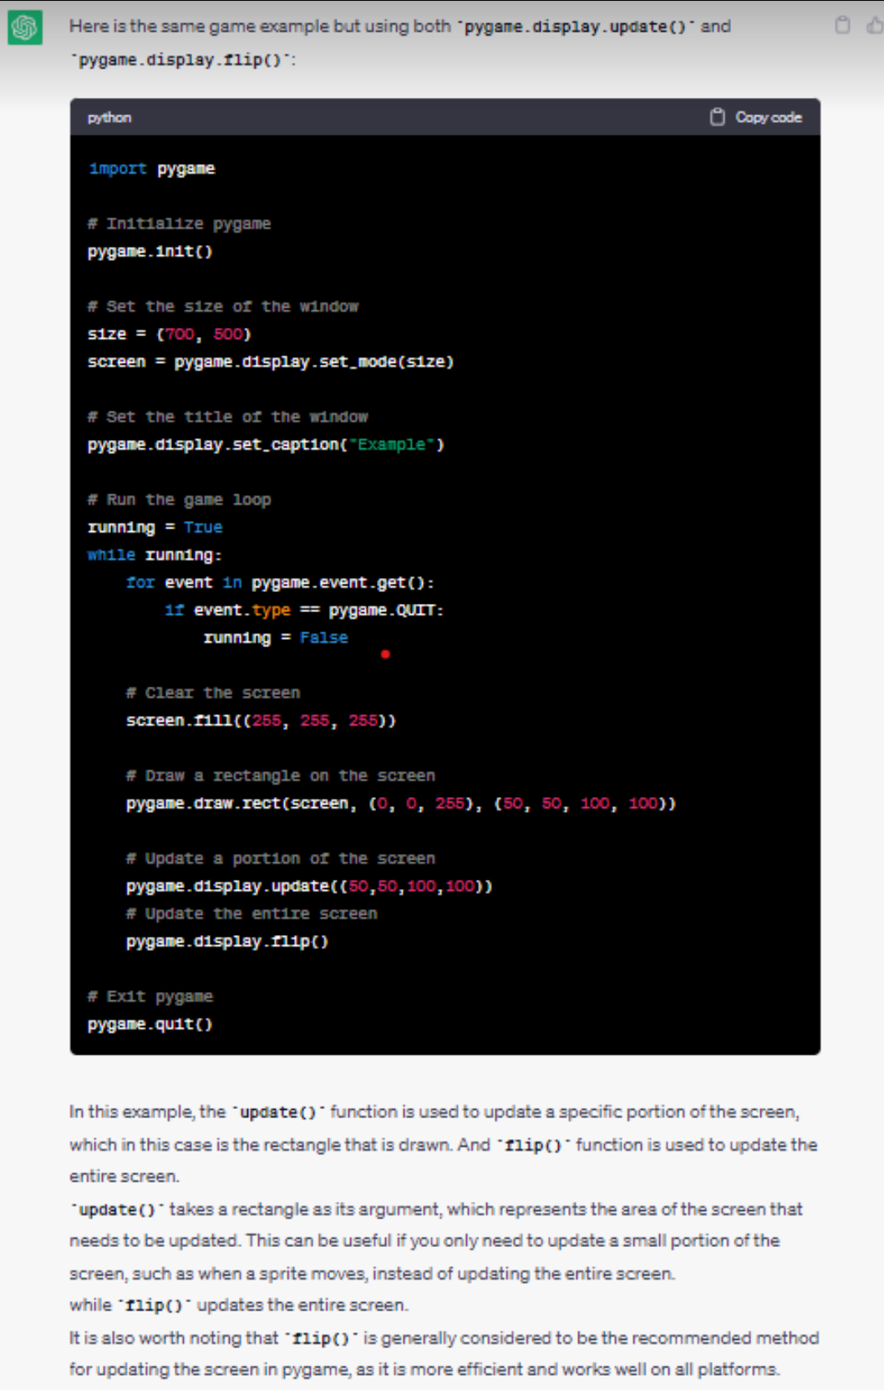
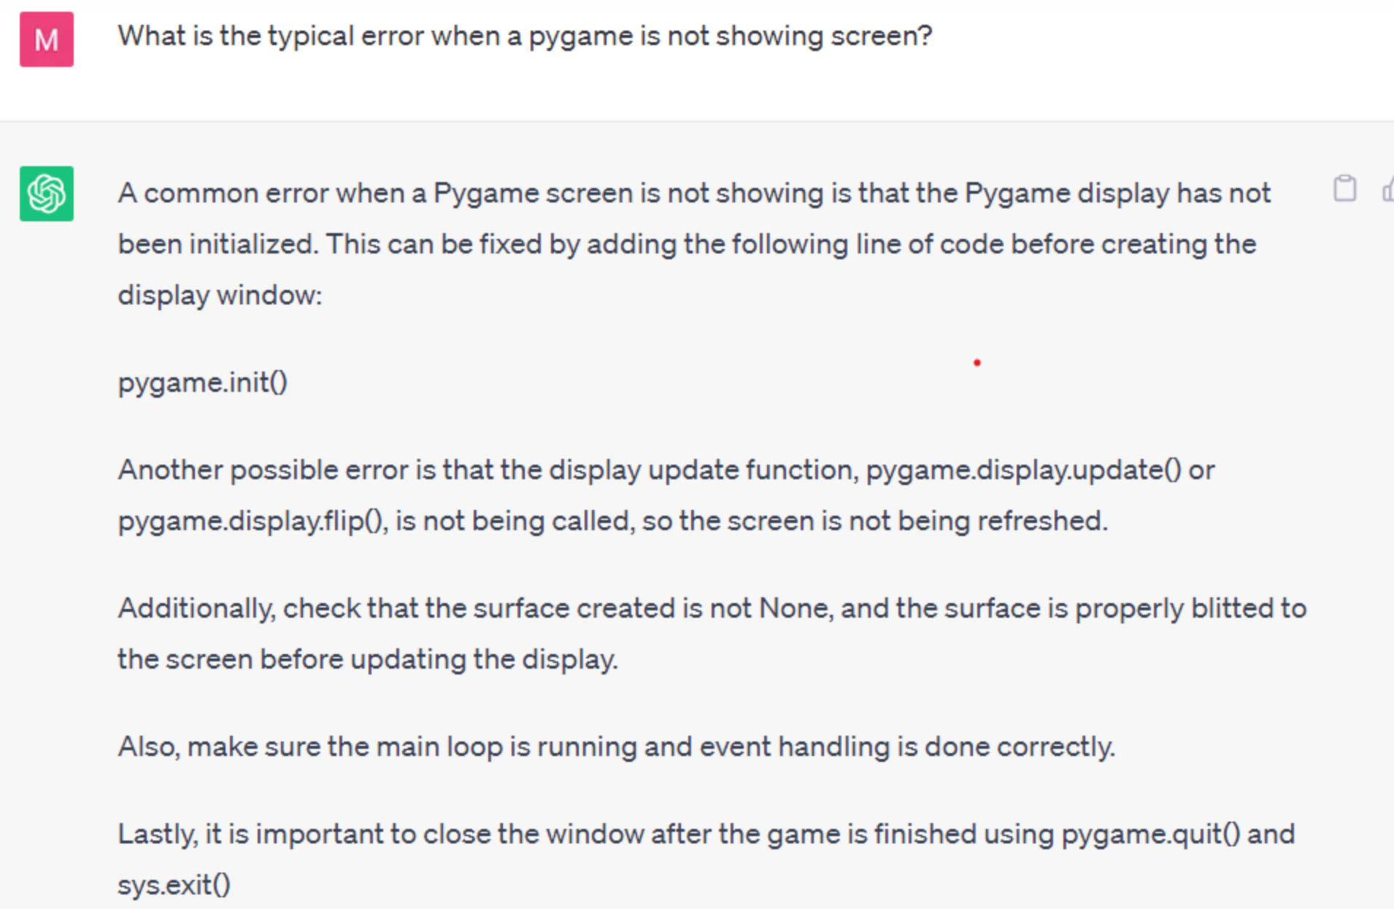
Coding with ChatGPT

Slide 8
Conclusions, February 2023
ChatGPT does not do calculations, ChatGPT tells STORIES
ChatGPT does not execute code , ChatGPT tells STORIES
ChatGPT does not do symbolic reasoning , ChatGPT tells STORIES
ChatGPT makes factual errors
ChatGPT gives inconsistent answers
ChatGPT tells STORIES
But: ChatGPT can help fixing bugs faster than Google

Slide 9
Phase 2 – Late March 2023 ChatGPT4 Transition

Slide 10
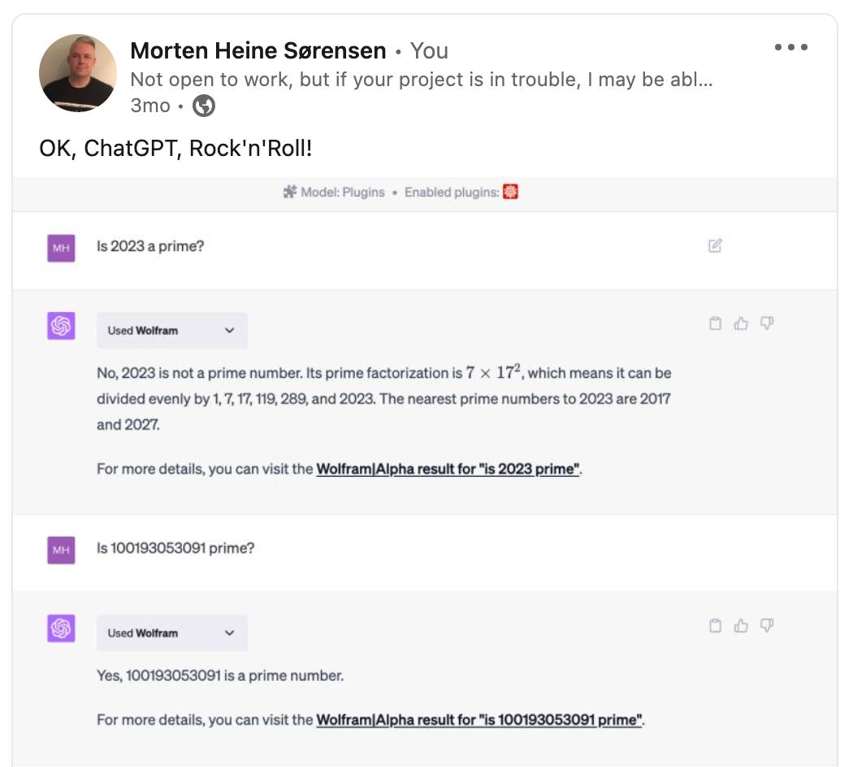
Using plugins

Slide 11
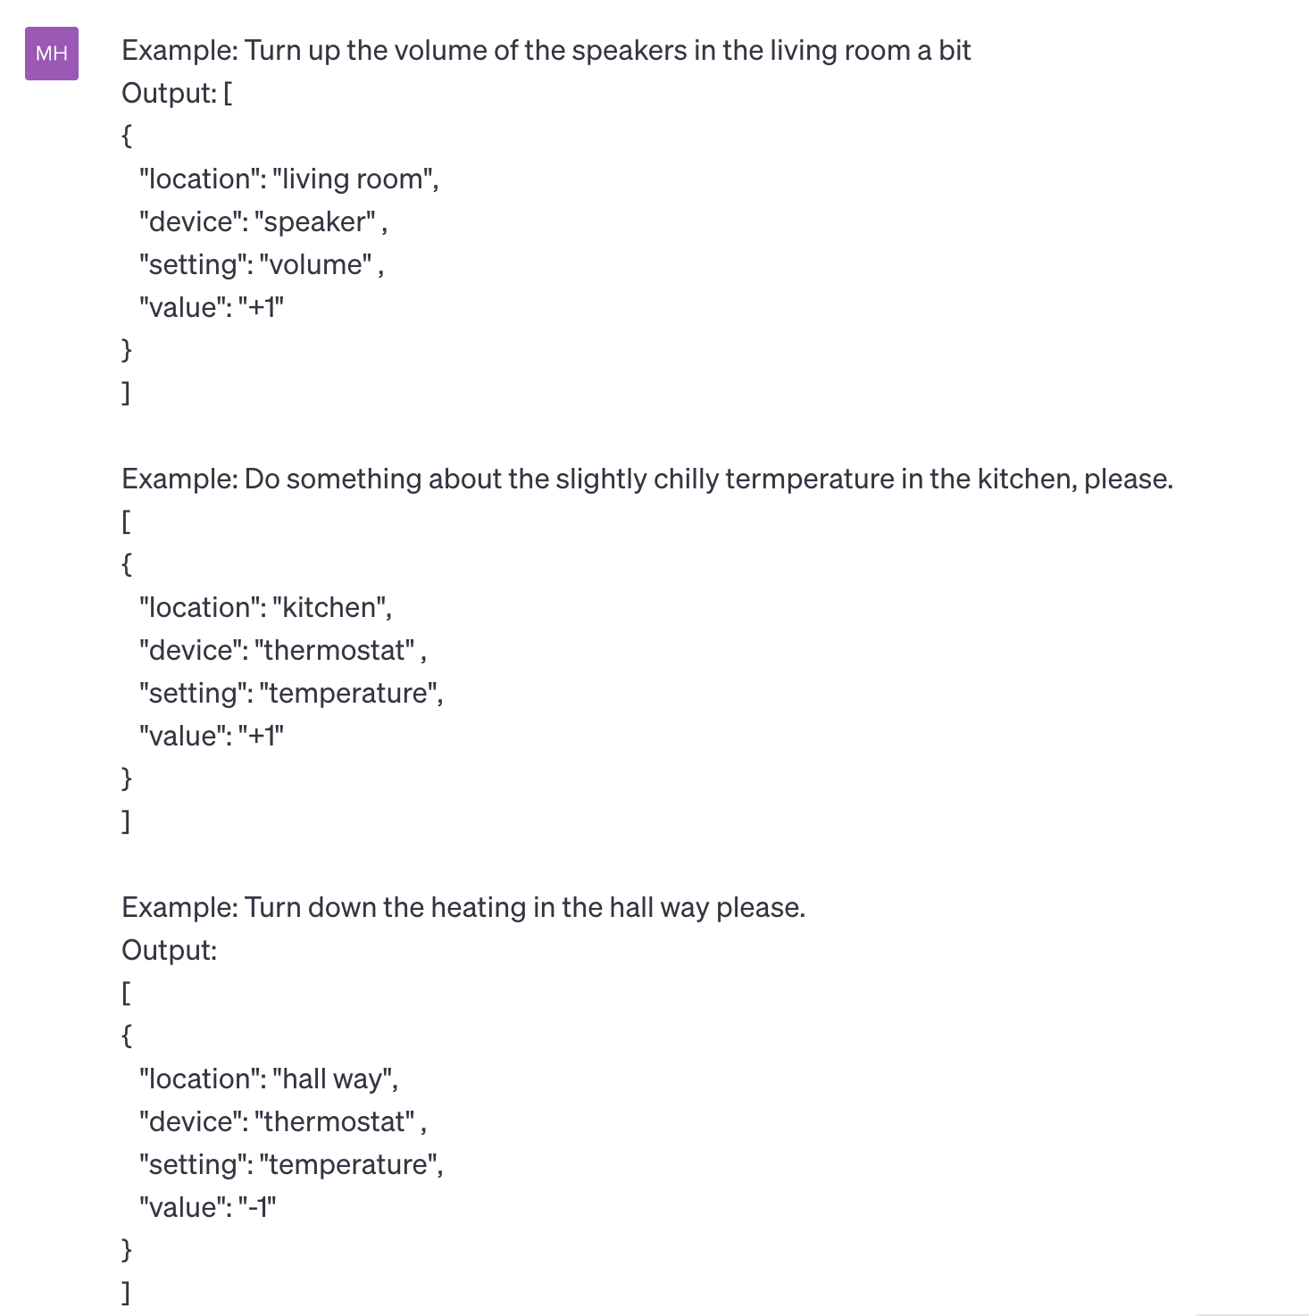
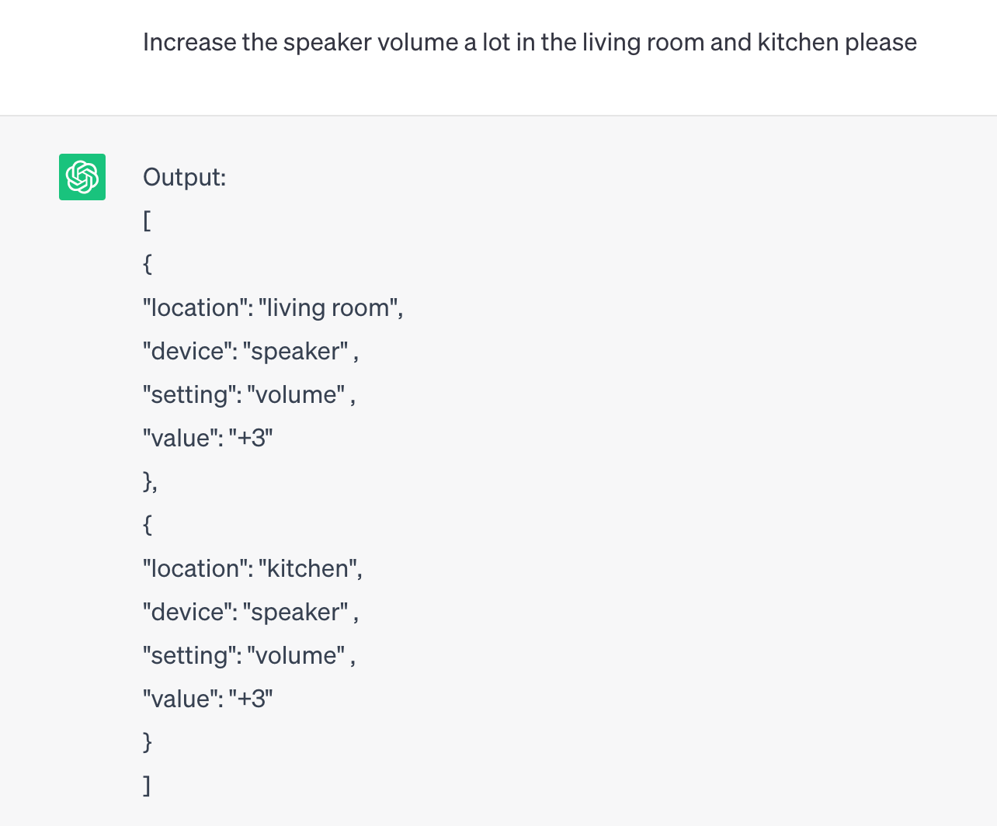
Open the pod bay doors, HAL

Slide 12
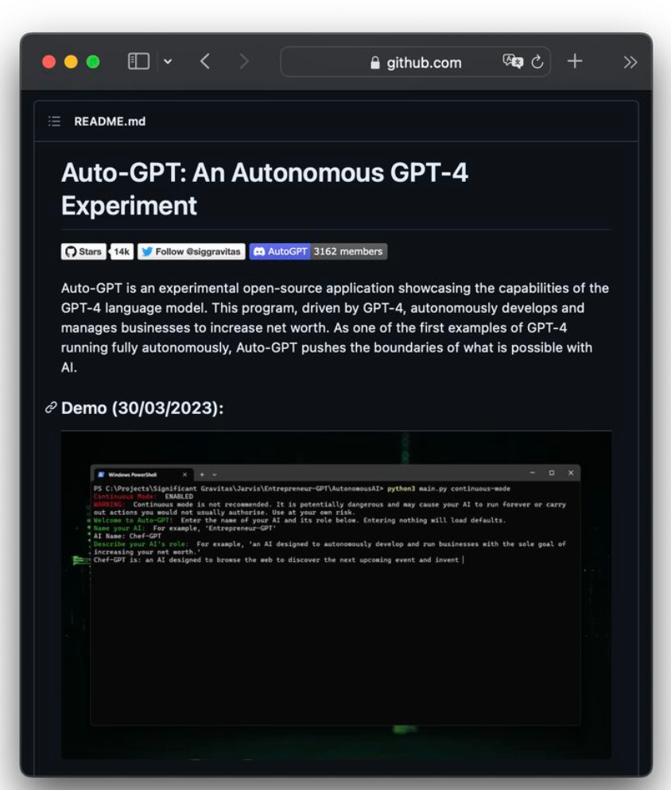
Open AI API
Ability to call ChatGPT
An ocean of possibilities for apps

Slide 13
Conclusions, May 2023
ChatGPT delegates to plugins
They can do calculations
They can execute code
They can do symbolic reasoning
You can call its API and use the response to call other APIs
Overall model provides better answers
ChatGPT still tells stories – this is the model
The model is an advantage

Slide 14
Phase 3 – Summer 2023 ChatGPT4 New Era

Slide 15
LinkedIn rumours
Experienced developer 1:
ChatGPT is a factor x quicker coder than me.
Experienced developer 2:
Last year if I got $x mio for startup, I’d hire a team of devs.
Now I would use ChatGPT.
Prompt Engineering
Lots of fuzz.

Slide 16
Reported experiments (selection)
Danusha Navod Gamage: 7 Ways ChatGPT Can Help Developers.
Generate code snippets
Write test cases
Fix defects
Etc.
Martin Fowler: An example of LLM prompting for programming.
Add a feature to an enterprise application
Mike Loukides: Real World Programming with ChatGPT.
Same as above.
David Gewirtz: How to use ChatGPT to write code.
Partial implementation of browser plugin to play tunes matching research articles.
Philip Guo: Real-Real-World Programming with ChatGPT.
Wordpress plugin.

Slide 17
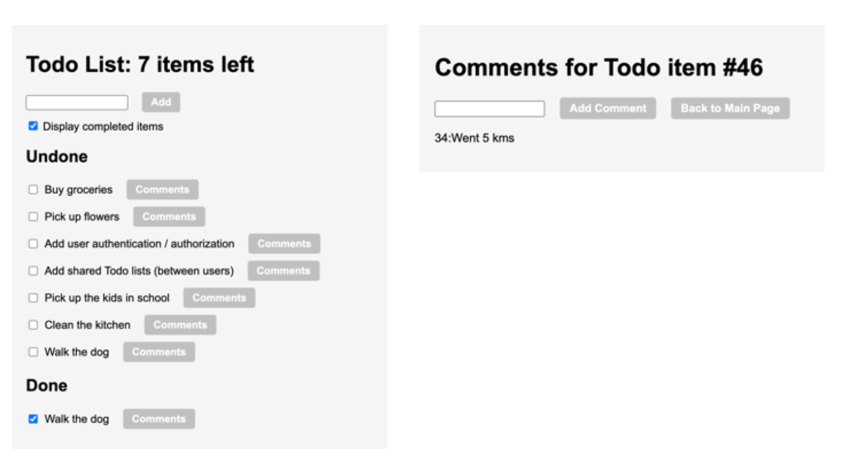
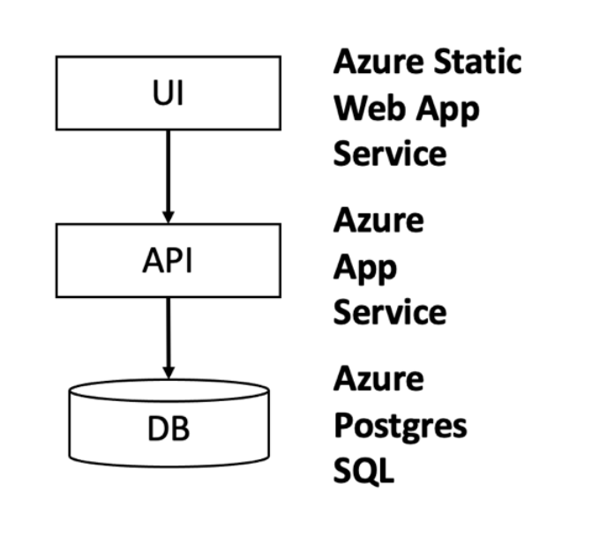
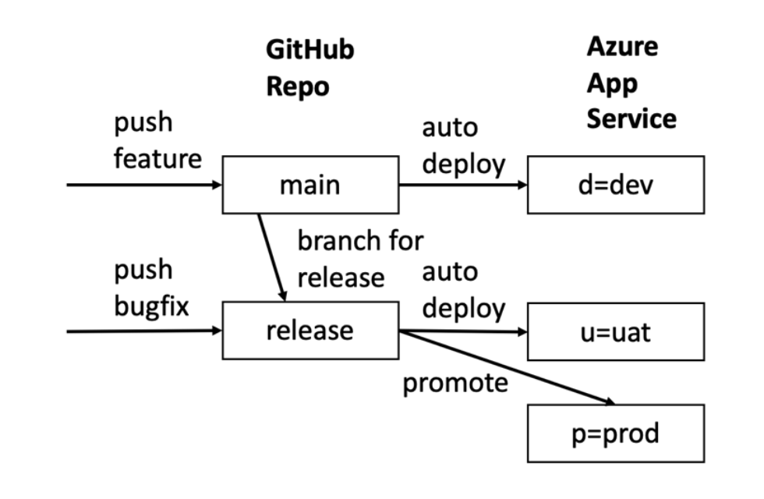
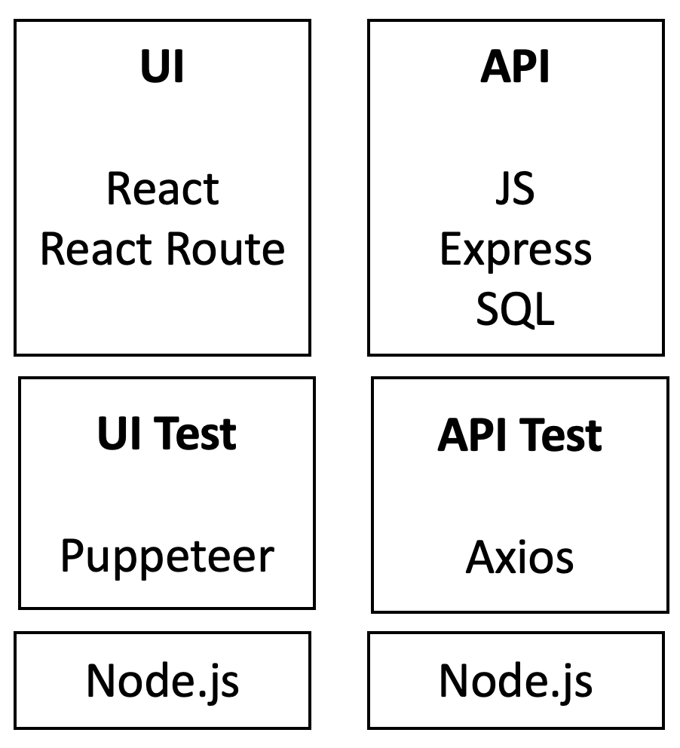
Scaling Real-world application development
LESSON 1: ChatGPT can provide tutorials on how to accomplish tasks that are tailored to your specific application, making them very easy and fast to use.
Steps:
Set up the project
Create the data model
Create the API
Create the UI
Create the styling
Create the tests
Refactor common parts
Mature the application
Set up environments+pipelines
Scale with formalism
Scale with developers
Full-stack representative application:
UI built with React.
API built on Node.js.
Data layer with Postgres database.
Αππροαχη:
Στανδαρδ αππροαχη ωιτη δεϖελοπερσ
Σπριντσ
Ρελεασεσ
Ενϖιρονμεντσ
Πυλλ−ρεθυεστσ
Υσερ−στοριεσ
ΥΙ Σπεχσ
ΔΒ ανδ ΑΠΙ σπεχσ
Δελεγατε υσερ στοριεσ/σπεχσ το ΧηατΓΠΤ
Ρεχειϖε πυλλ−ρεθυεστσ φρομ ΧηατΓΠΤ
LESSON 3: Split the development into sprints and user stories, like you would with a team of developers. Then proceed sprint by sprint, user story by user story, for the same reasons as you normally do.
LESSON 5: Except for mock-ups, UI experimentation and hobby projects, most sprints should start by implementing the data model of the feature.

Slide 18
Dialogues – Set up project
Install node
Install IDE
npx create-react-app
Project
File structure
Skeleton
Run the sample application
LESSON 2: Spend the time needed to set up the local development environment to efficiently support the iterations with ChatGPT. It does not matter if this take a bit more time than ideal since it will be a one-time cost.

Slide 19
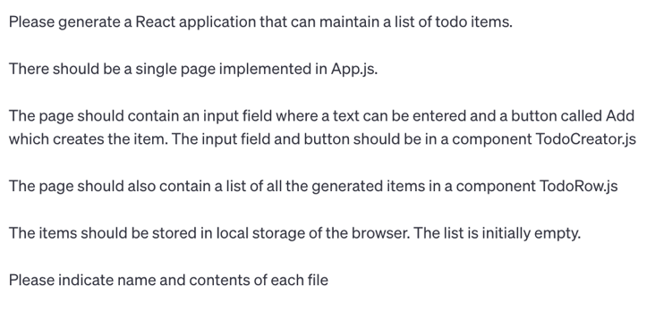
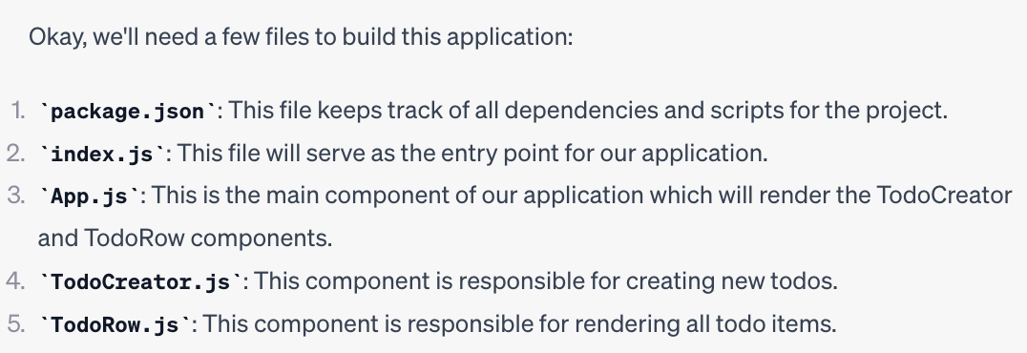
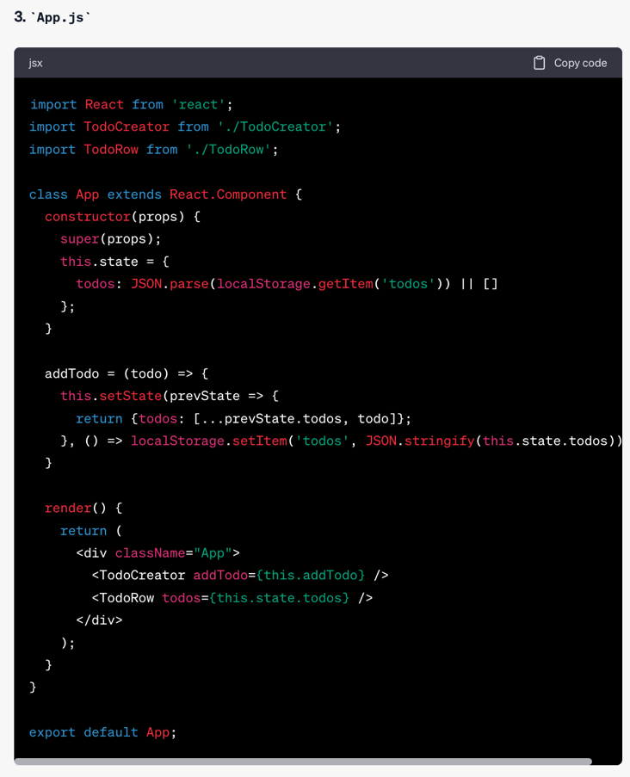
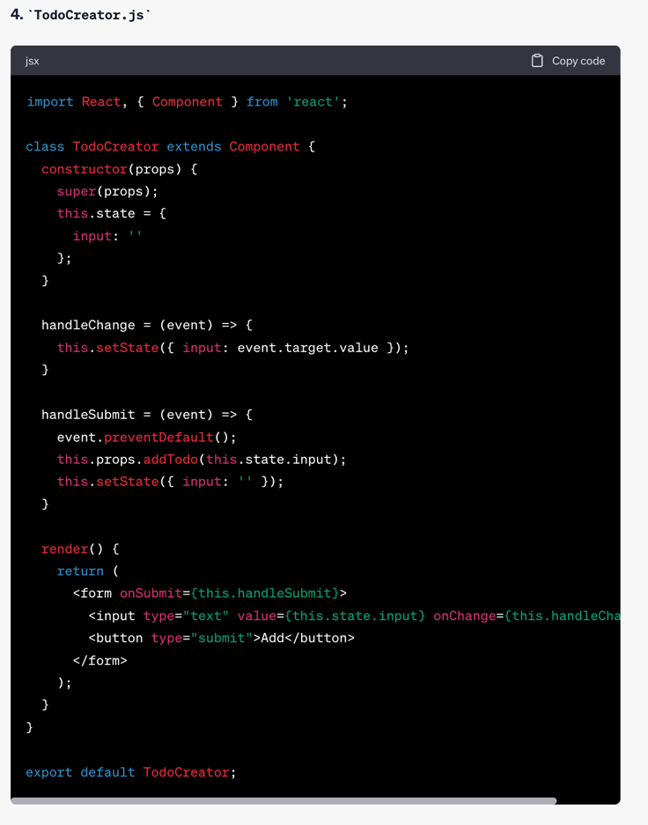
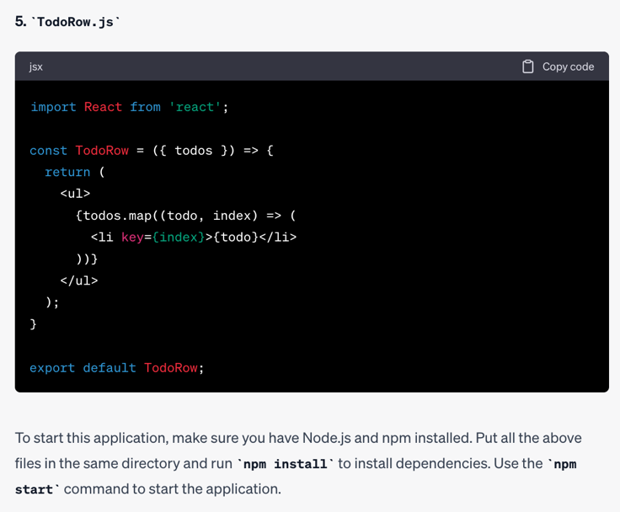
Dialogues – First part of UI
LESSON 4: In Sprint 1, establish the fundamental architecture of the application, for instance a UI layer, an API layer, and the DB layer developed well enough to cover a small feature. The fundamental architecture should not only align to functional and non-functional requirements, but also to the team size and team experience.
LESSON 8: When working with ChatGPT on User Interface, ask first for a simple version. Then add remaining controls one by one or in small groups.
LESSON 6: ChatGPT’s answers should be evaluated like they come from another (sometimes less experienced) person, rather than from a flawless machine. The human developer who integrates ChatGPT’s responses into the application remains liable.
LESSON 10: When starting the interaction with ChatGPT, have a dummy application working.

Slide 20
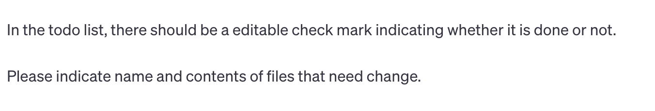
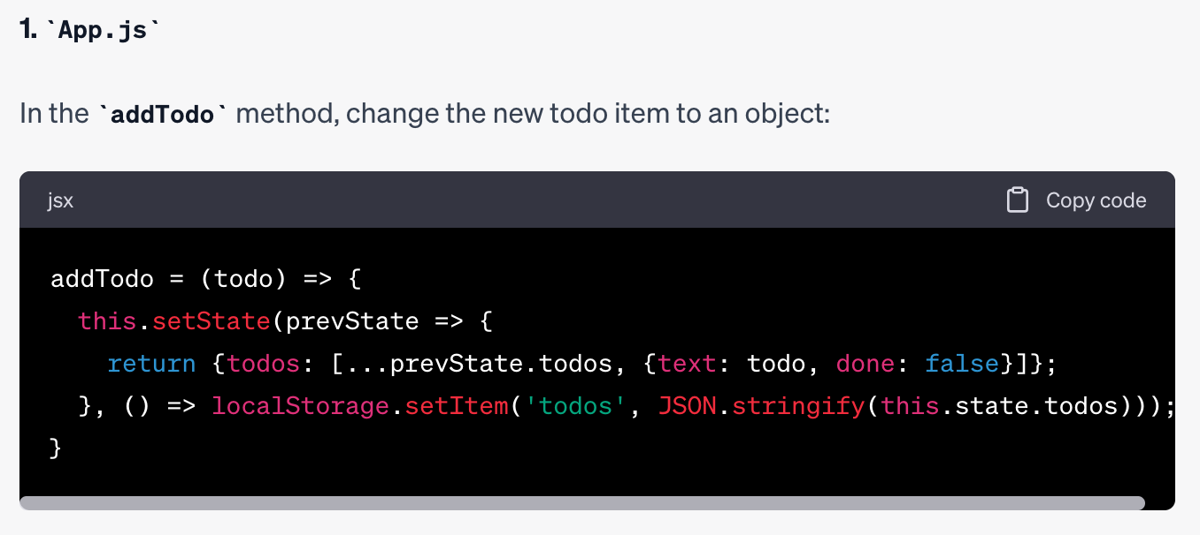
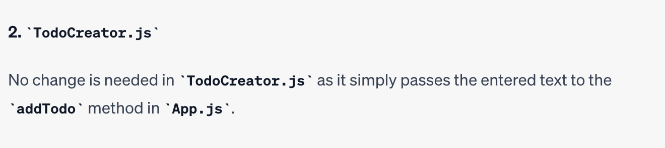
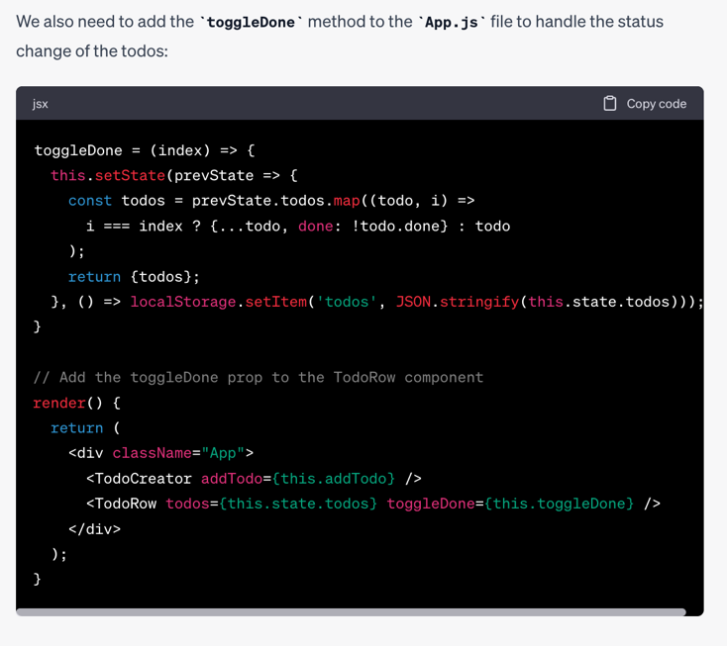
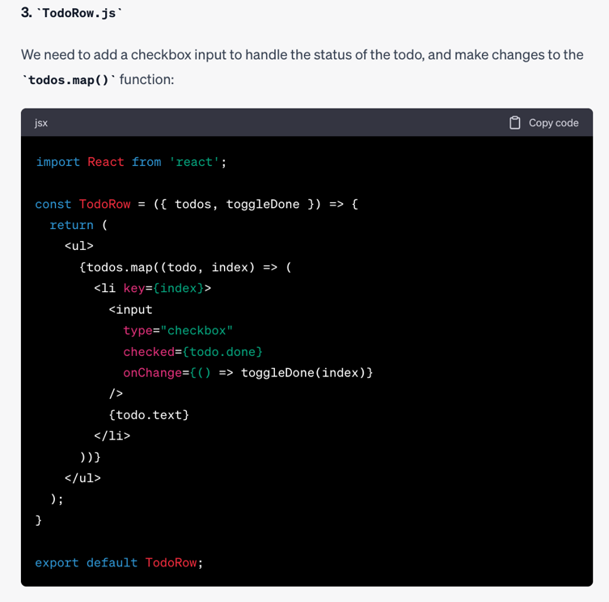
Dialogues – Todo done checkmark
LESSON 9: Ask for full contents of files. It speeds up the process.

Slide 21
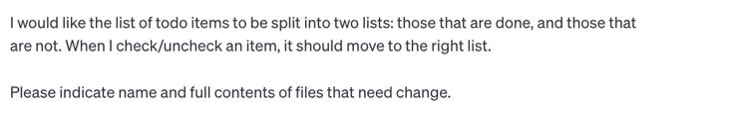
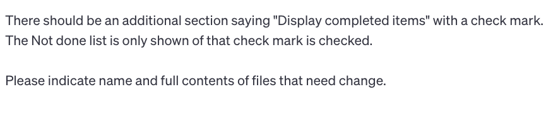
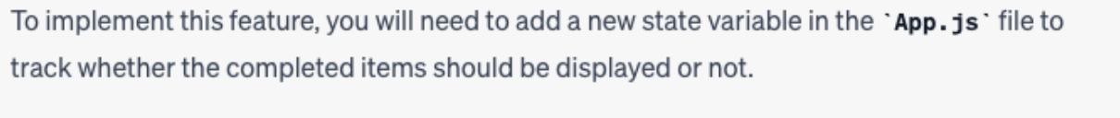
Dialogues – Separate done and undone items
Details omitted
Details omitted

Slide 22
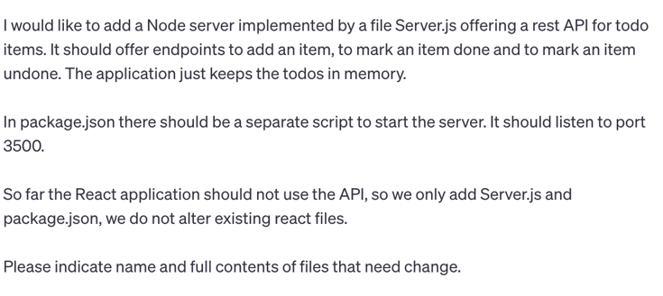
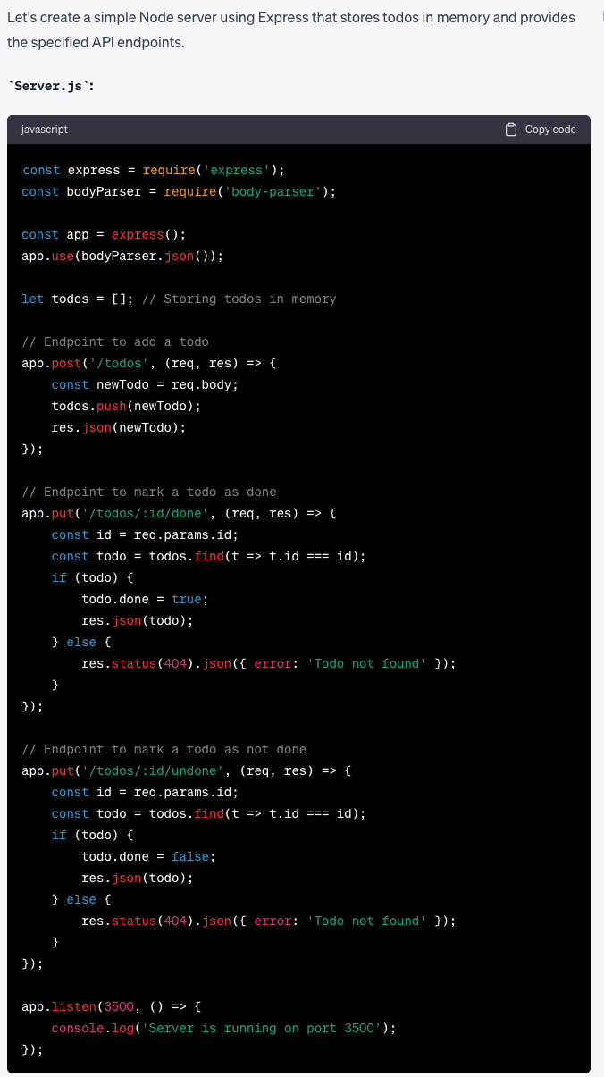
Dialogues – Create the server
LESSON 7: When starting the API, get a simple server running with a simple example and make sure you are happy with it to some level of maturity. There may be some production hardening missing that can be covered latter, but the basic structure should be correct and satisfactory.

Slide 23
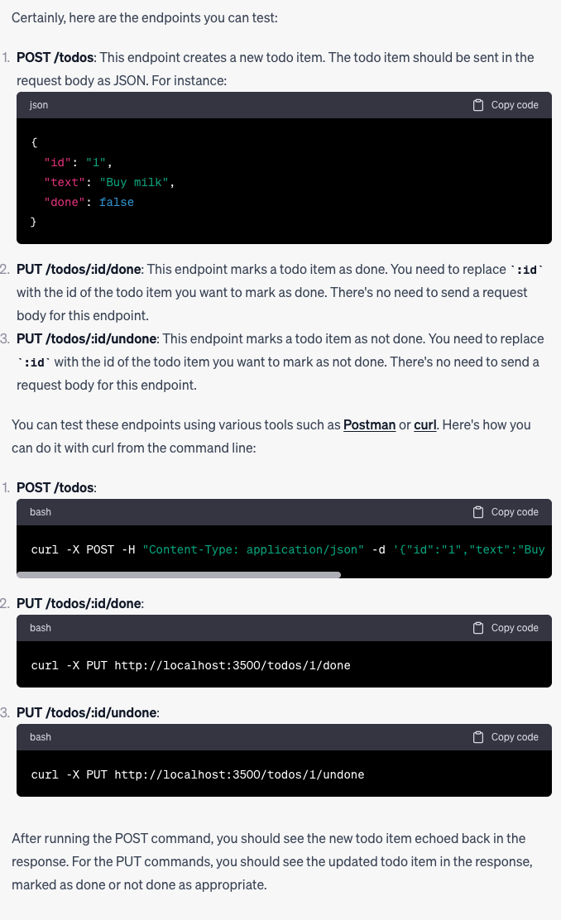
Dialogues – Testing the server

Slide 24
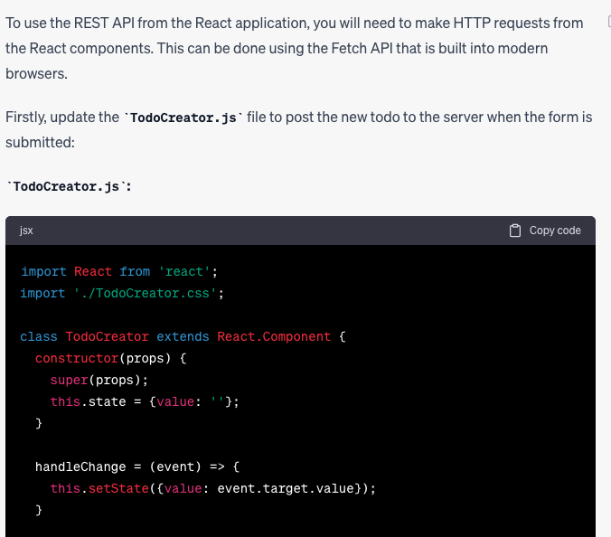
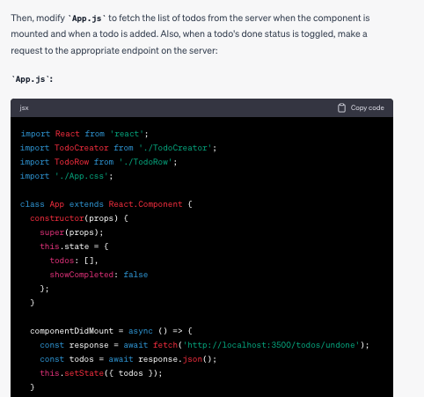
Dialogues – Using the endpoints from the UI
Details omitted
Details omitted

Slide 25
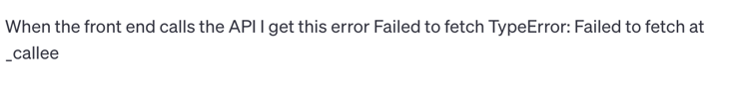
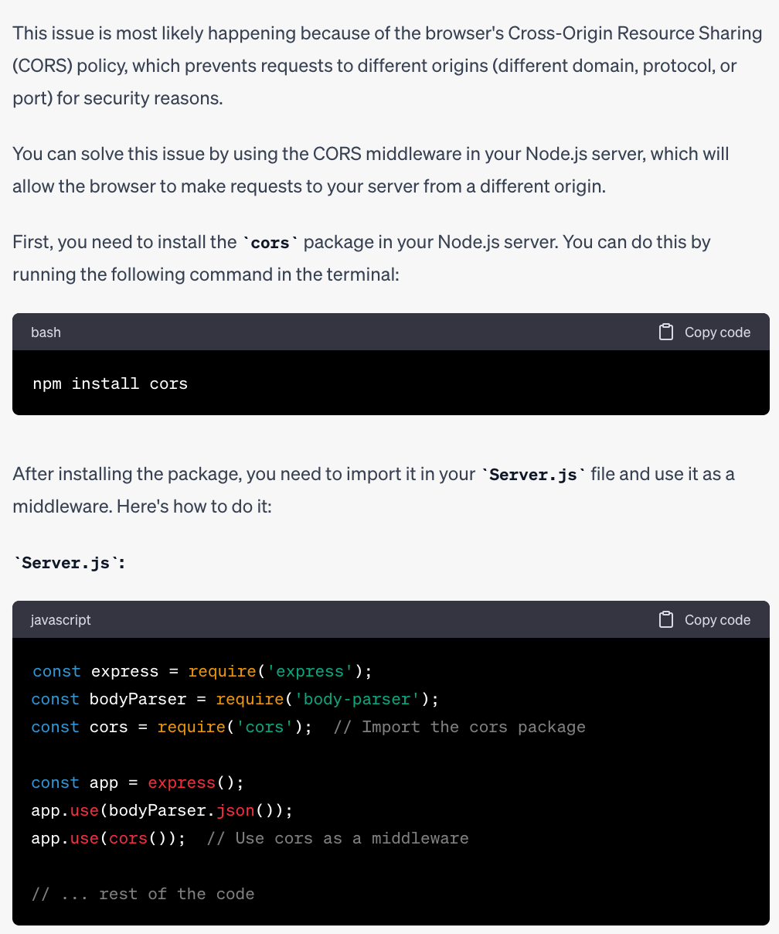
Dialogues – An error
LESSON 11: ChatGPT may generate code with issues for various reasons, e.g., because we did not ask explicitly to avoid them or because he made an interpretation that is incorrect in our context. In such cases, simply ask for help; most of the time he will be able to (help) resolve the problem.
LESSON 12: As mentioned, ChatGPT may generate code with errors but getting it to fix them is quicker than writing the code yourself, which may also introduce errors that may take time to find and resolve.
LESSON 13: ChatGPT may generate code with problems that were solved earlier in the dialog. You need to test what he returns at every step and ask errors to be fixed.

Slide 26
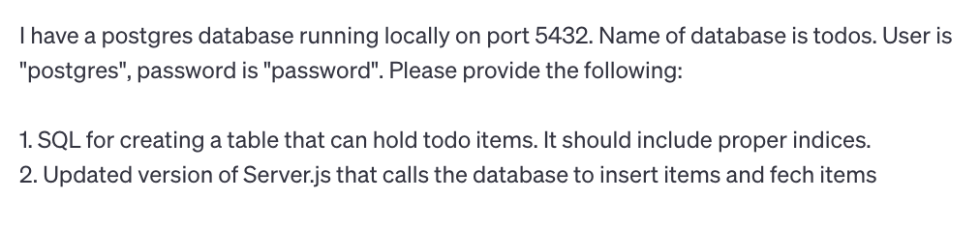
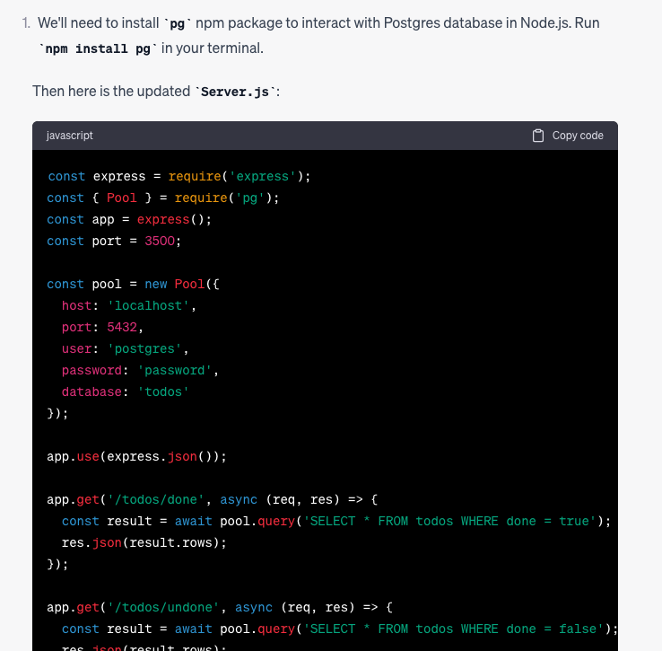
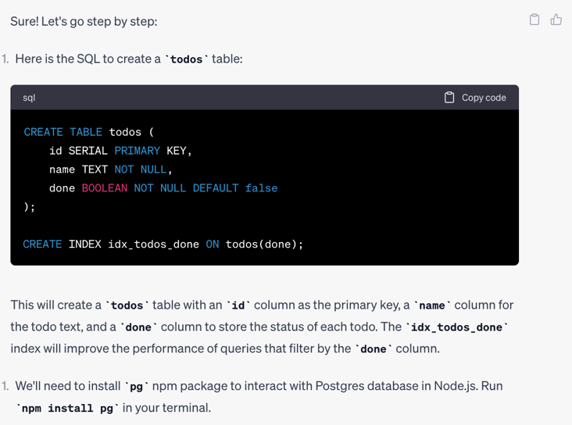
Dialogues – Creating the database
LESSON 14: Be as precise as you can in stating what you need from ChatGPT. Whenever you omit details, ChatGPT may do something else than you expect.
LESSON 15: If ChatGPT is lacking context, he may make assumptions instead of asking for clarifications. You can circumvent this by explicitly directing him initially to ask clarifications.

Slide 27
Dialogues – Other parts
LESSON 16: Sometimes, several iterations do not bring you closer to a solution. In these cases, consider reverting to classical techniques, like Googling, Stack Overflow, YouTube demos, reading the documentation, etc.
Create the styling
Create the tests
Refactor out common parts
Mature the application
Set up the prod environment
Scale with formalism
Scale with developers
Dealing with limitations
LESSON 17: ChatGPT currently does not know about knowledge published after September 2021
LESSON 18: ChatGPT generates several errors. It is valuable to have a slim UI test and API test that can be run locally before merging pull requests.
LESSON 20: As you review the PRs from ChatGPT, keep an eye on parts of the code that could or should be refactored. Either do the refactoring yourself or ask ChatGPT to do it.
LESSON 23: See the code by ChatGPT as your code. You must be able to account for it. That way it has same value as code developed by you or your developers.
LESSON 24: The code that you get from ChatGPT may not be ready for production, but he can help you understand what needs to be checked and how, and which changes are needed as a result of the checks.
LESSON 25: Formalize your communication with ChatGPT with initial training. That way the communication can hopefully be way more efficient and less ambiguous.

Slide 28
Is ChatGPT just another tool?
Google Search
Stack Overflow
Who Answers It Better? An In-Depth Analysis of ChatGPT and Stack Overflow Answers to Software Engineering Questions.
More than 50% of ChatGPT’s answers contain inaccuracies.
Scenario where SO shines.
In my experience, ChatGPT is good at solving problems in own code.
GitHub Copilot
Research: quantifying GitHub Copilot’s impact on developer productivity and happiness.
Devs using CoPilot are more than 2 x faster than devs not using CoPilot.
IDE vs Browser.
Code completion/pull requests vs broad managin code, tests, bugs.
McKinsey
Unleashing developer productivity with generative AI.
Devs up to twice as fast with generative AI.
Expediting manual and repetitive work.
Jump-starting the first draft of new code.
Accelerating updates to existing code.
Increasing developers’ ability to tackle new challenges.
Google DeepMind: AlphaCode
Amazon: CodeWhisperer
Microsoft: Copilot
Google: Bard
Google: Gemini
OpenAI: ChatGPT5

Slide 29
What’s New?
Summer 2024 – Improvements and Criticism
Features:
Upload and download files, cool
Able to process images, cool
Generate HTML/CSS from image, multiple iterations needed and can only get to a certain point before it gets worse
Claude (see below) comparable
UI offerings
Generate React from Figma (multiple) – I don’t want to create Figmas
Fronty: create website – I want pages
Image2codeai – I want free trial
Other offerings not working – I want something working
Customized “GPTs”
Competitor Claude
Business standard: ChatGPT costs $700,000 daily, maker may go bankrupt in 2024
Hicks et al.: ChatGPT is bullshit
Critics claim they were right
Proponents claim they were right
Limitations on what code can be sumitted due to privacy considerations
McKinsey: “Inaccuracy: The most recognized and experienced risk of gen AI use.” Not a problem for us.

